Slide 1
Project : SkillMatch Resume Matcher and Skill Recommendertegies
Presented by A.Ezhilarasan

Slide 2
Agenda
Artificial Intelligence (AI)
Machine Learning (ML)
Numpy
Pandas
Seaborn
Matplotlib

Slide 3
What is Artificial Intelligence (AI) ?
Artificial Intelligence (AI) is the ability of machines to mimic human intelligence like learning, reasoning, and decision-making—to solve problems or perform tasks.
For example, AI powers virtual assistants like Siri or Copilot,which understand voice commands and respond intelligently.

Slide 4
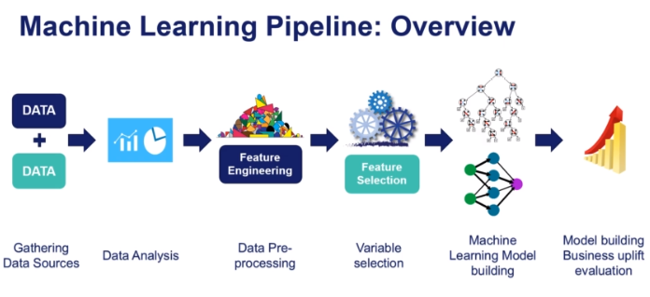
What is Machine Learning (ML) ?
Machine Learning, is a subset of Artificial Intelligence (AI) that focuses on enabling computers to learn from data and improve their performance on specific tasks without being explicitly programmed. It involves the development of algorithms that can identify patterns, make predictions, and adapt to new data over time.

Slide 5
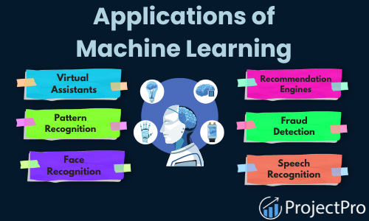
Application Machine Learning (ML)

Slide 6
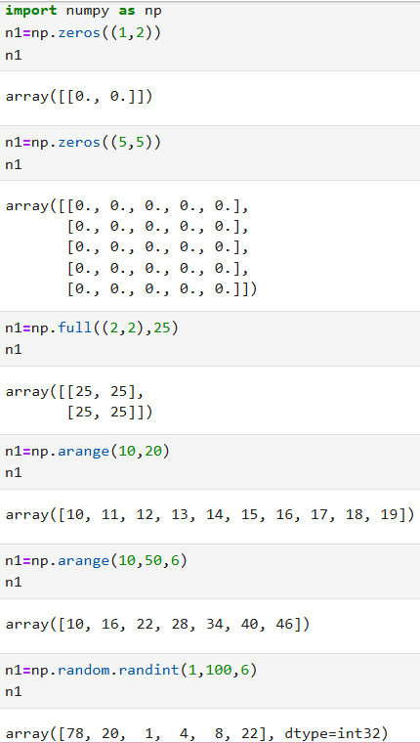
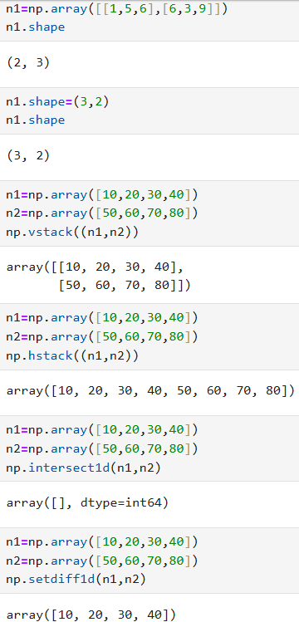
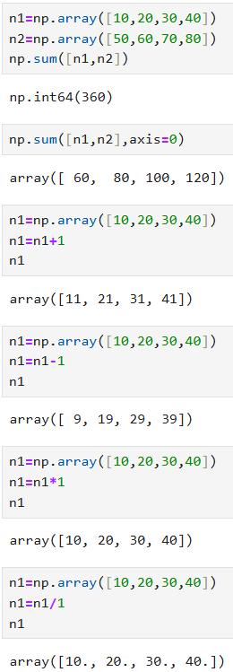
NUMPY
NumPy is a Python library for fast numerical computing, especially with arrays and matrices. It powers data science, ML, and scientific analysis.

Slide 7
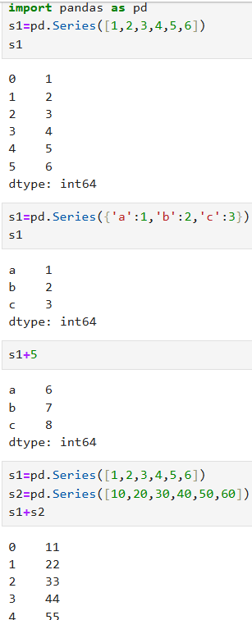
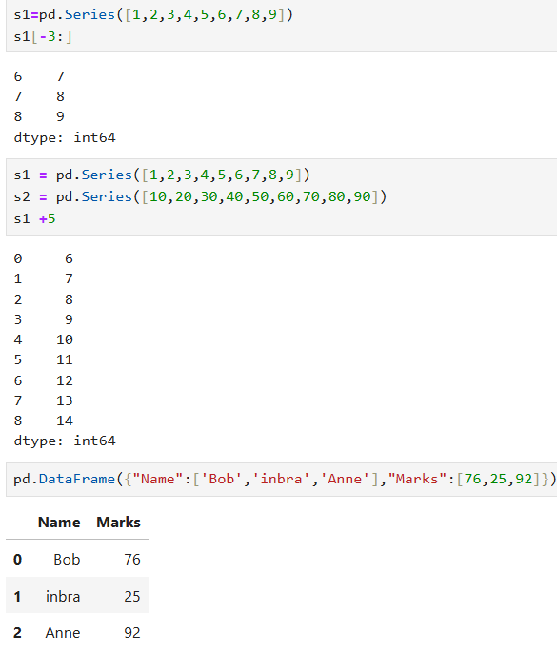
PANDAS
Pandas is a Python library for fast, flexible data analysis using tables and labeled arrays. It handles cleaning, filtering, grouping, and file I/O for structured data.

Slide 8
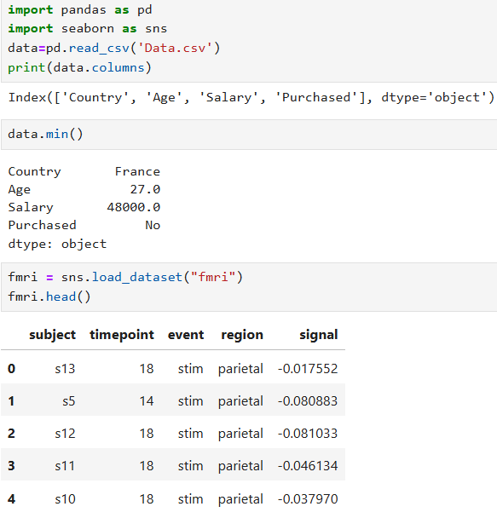
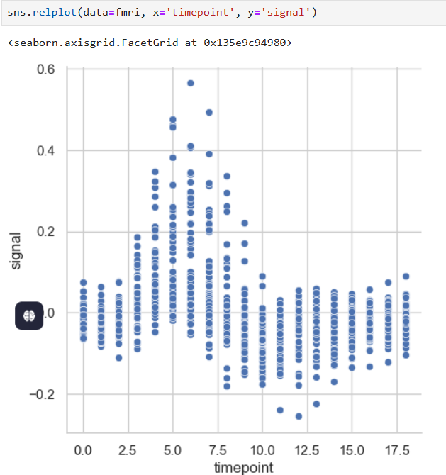
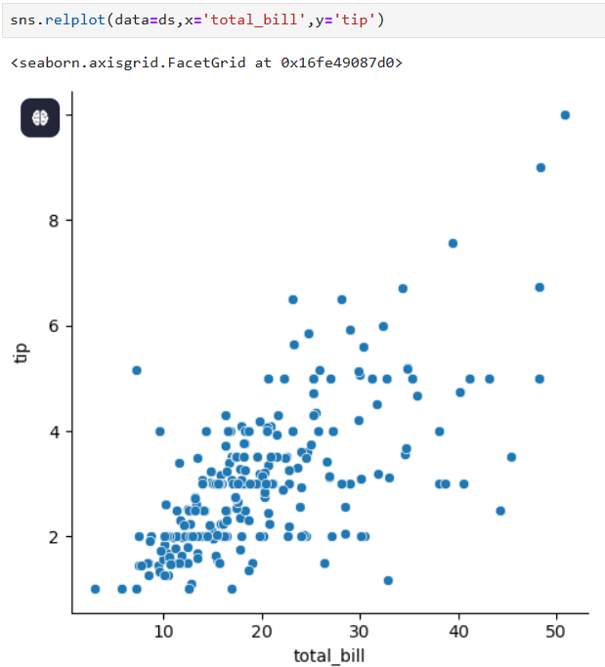
SEABORN
Seaborn is a Python data visualization library built on top of Matplotlib. It makes it easy to create beautiful, informative statistical graphics with just a few lines of code.

Slide 9
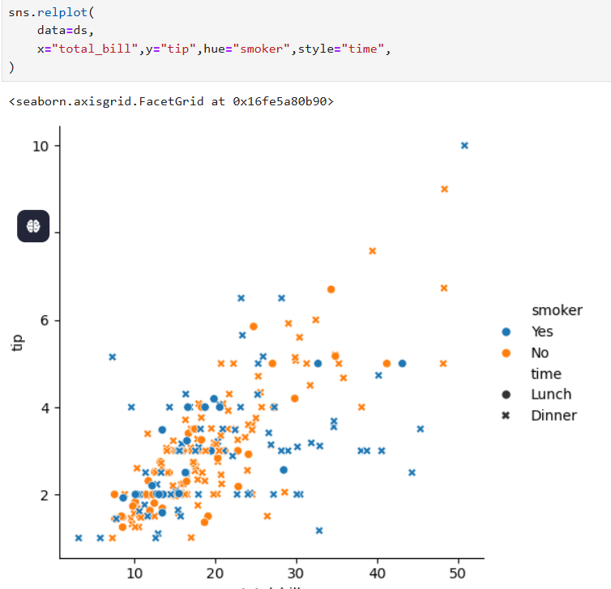
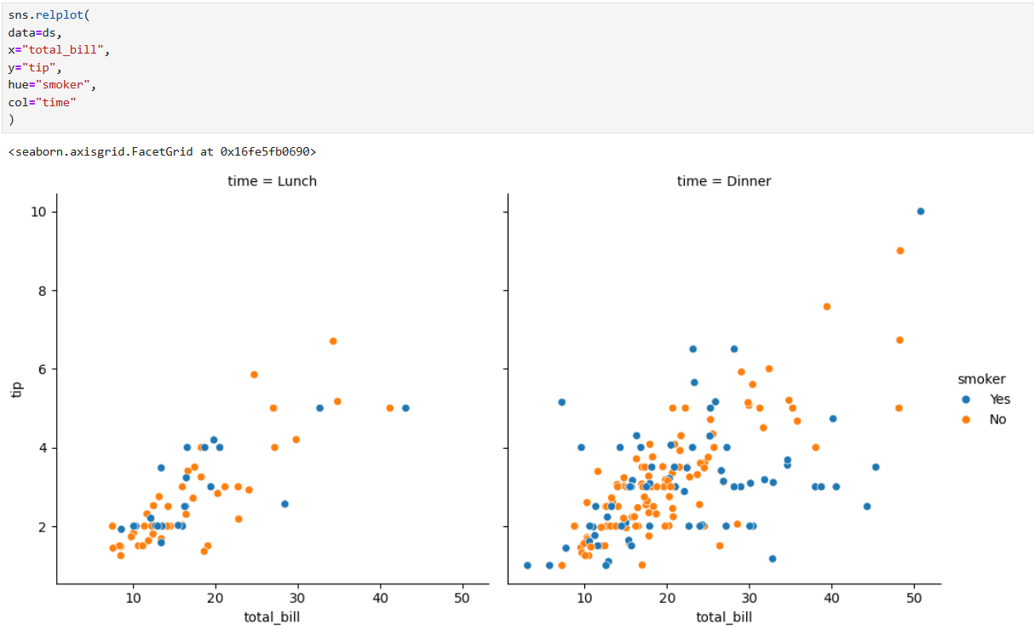
SEABORN

Slide 10
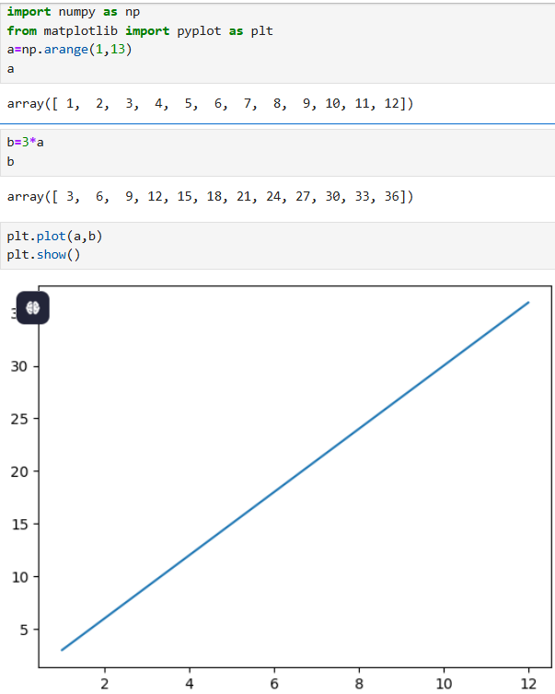
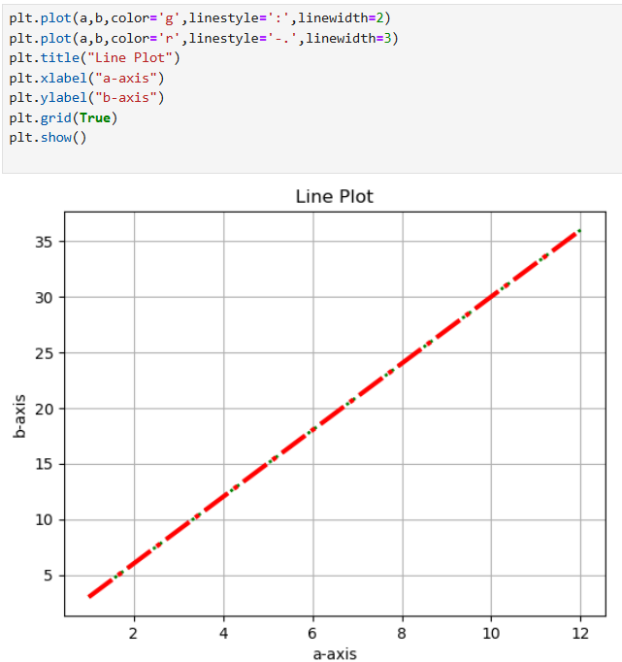
MATPLOTLIB
Matplotlib is a Python library for creating static, animated, and interactive plots. It’s widely used for visualizing data in science, ML, and analytics.

Slide 11
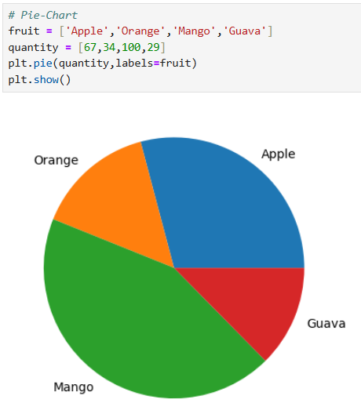
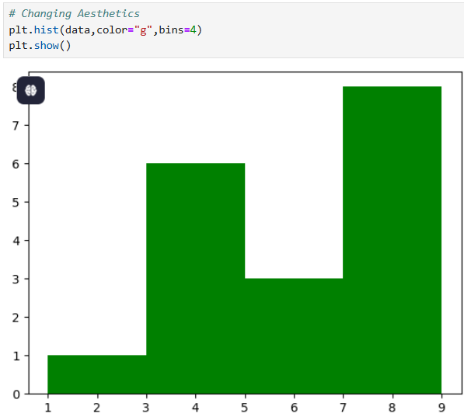
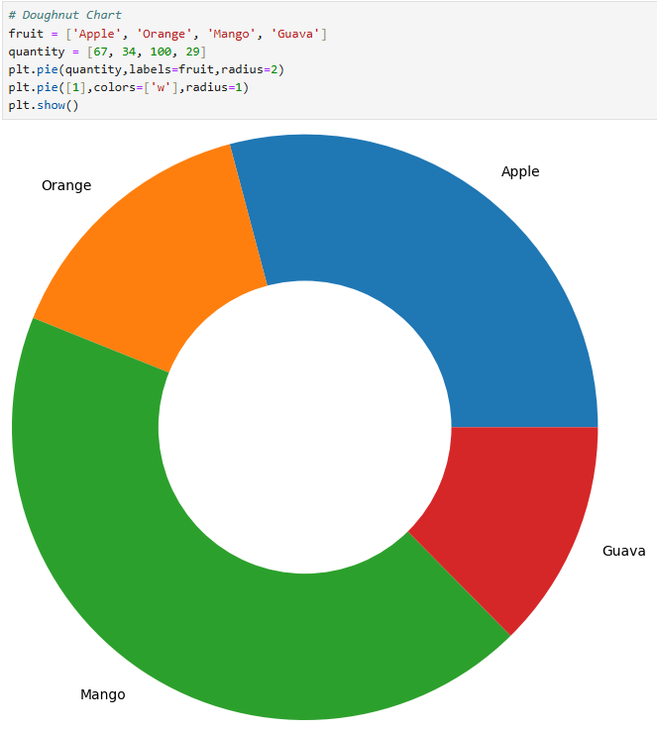
MATPLOTLIB

Slide 12
Thank you

